Slide 1
RA1811003010775 HITESH PARASHAR RA1811003010776 SHREEJAN MISHRA RA1811003010777 YASH PANDEY RA1811003010778 TUSHAR RA1811003010779 ARVETI RAGHAVENDRA
HOSPITAL MANAGEMENT SYSTEM

Slide 2
Abstract
This project Hospital Management system includes:-
Registration of patients, storing their details into the system with unique ID.
Storage of clinical details of every patient and hospital tests done automatically.
Information of doctor assigned to the patient and his details.
Computerized bill generation for the consultation, pharmacy, and labs.

Slide 3
Introduction
Hospital management system is a computer system that helps manage the information related to health care and aids in the job completion of health care providers effectively.
HMS was introduced to solve the complications coming from managing all the paper works of every patient associated with the various departments of hospitalization with confidentiality. HMS provides the ability to manage all the paperwork in one place, reducing the work of staff in arranging and analyzing the paperwork of the patients. HMS does many works like:
Maintain the medical records of the patient .
Tracking the bill payments.
The advantages of HMS can be pinpointed to the following:
Time-saving Technology
Improved Efficiency by avoiding human errors
Reduces scope for Error
Data security and correct data retrieval made possible

Slide 4
Software Used
SQL Developer by Oracle
We used Oracle live because of its:-
Performance and Scalabilty
Indicators for all key words, reserved words
Portability
Market Presence
Multiple Database Support
Security
Backup and Recovery
Easy error detection and removal.

Slide 5
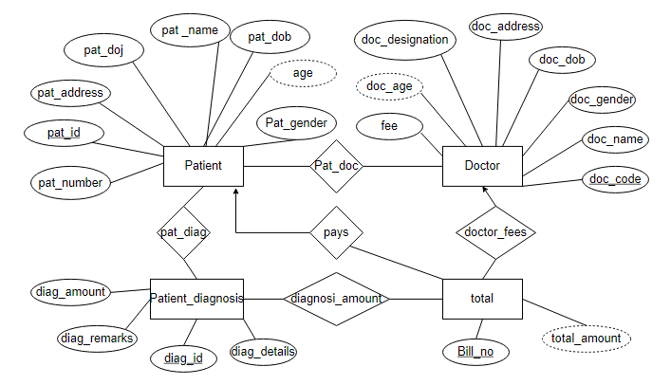
ER Diagram

Slide 6
Concepts used
PL/SQL
Trigger
Exception handling
Sequence
Views

Slide 7
Output

Slide 8
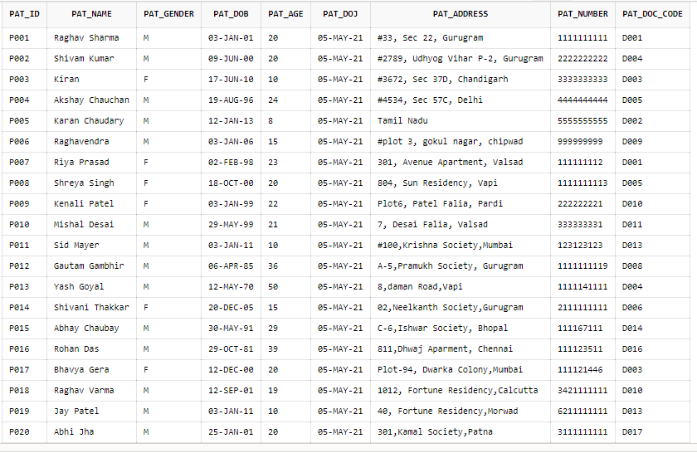
Patient Table

Slide 9
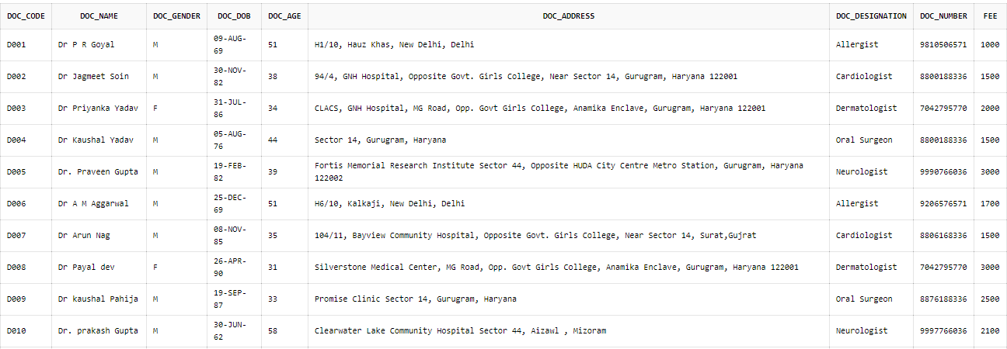
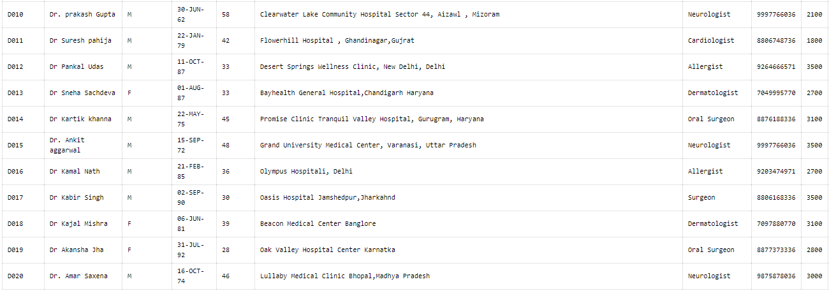
Doctor

Slide 10
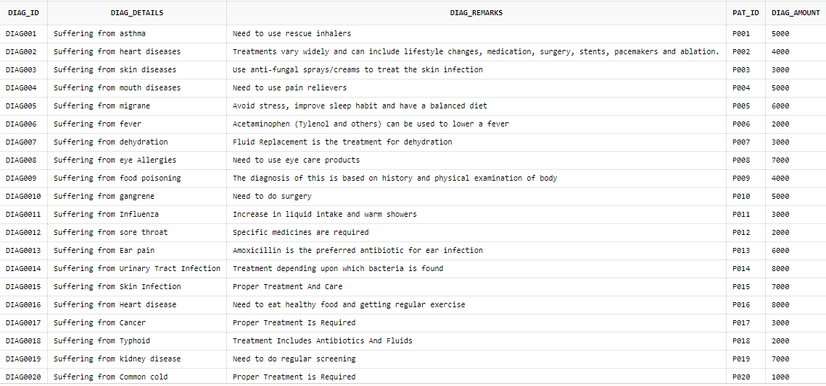
Diagnosis Table

Slide 11
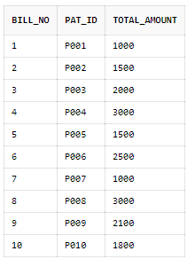
Total Table

Slide 12
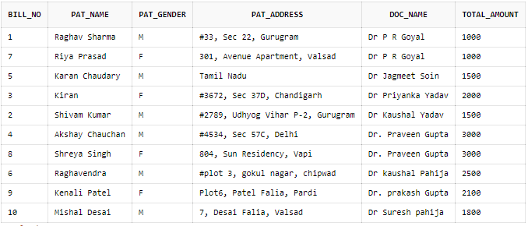
Bill view

